Slide 1
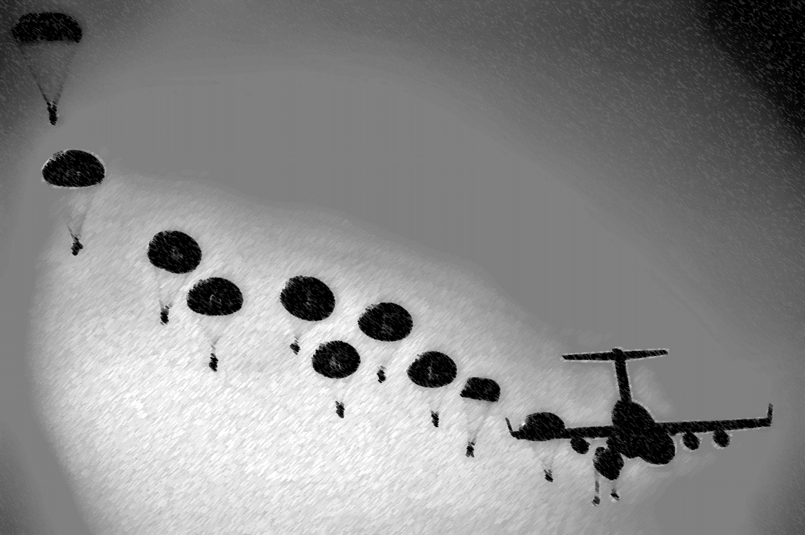
playerunknown’s Battlegrounds:
Visualization and prediction

Slide 2
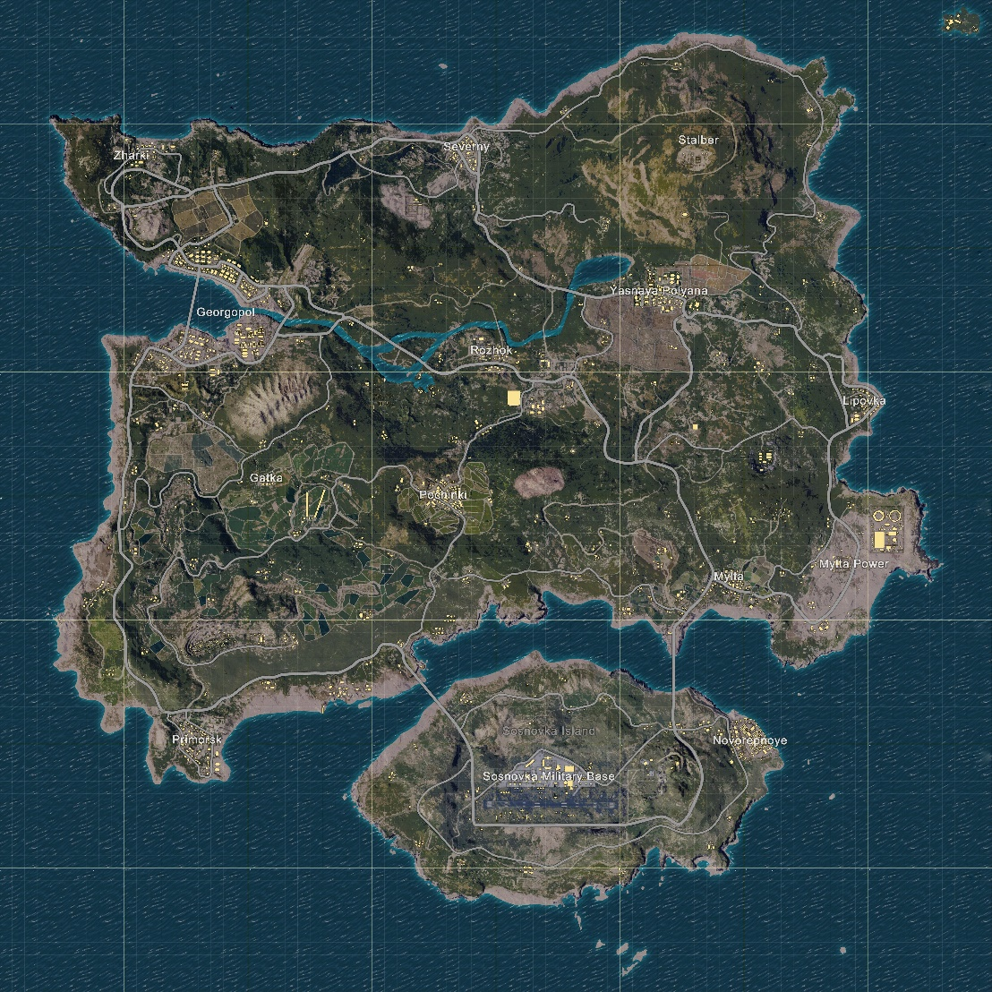
Welcome to erangel . . .
PlayerUnknown’s Battlegrounds (PUBG) is a multiplayer PC game released via Steam early access in 2017.
100 player battle (think Hunger Games)
Players can participate in solo games or in squad (team) based battles
Incredibly difficult to win, each game very different from the last
Has sold over 7 million copies (number one game played concurrently on Steam)

Slide 3
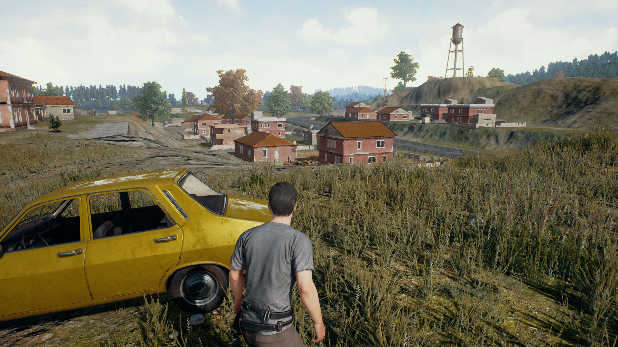
Player view

Slide 4

Project Objectives
1. Try to solve a new problem, and build a new data set
2. Use my software engineering background more
3. Contribute to open-source projects/initiatives
4. Explore game strategy using real data and unsupervised machine learning

Slide 5

Trn and pubg stats
https://pubgtracker.com/
Tracker Network (TRN) – One of the largest video game stat tracking websites
Tracks stats and produces leaderboards for PUBG
Features a relatively new RESTful web-API for developers… so, I requested a key
Several open source API wrappers for popular programming languages
But not one for R…

Slide 6
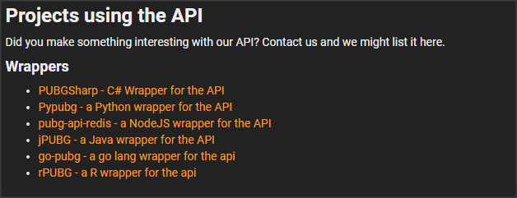
rpubg
So, I built one:
https://github.com/lazyjustin/rPUBG

Slide 7

Pulling data and ddos attacks
Wrote a Java HTML scraper to scrape leaderboard information off of pubgtracker.com
Used the scraper to build a list of player names (100,000 of the topped rank players across all geographic regions)
Created a master .csv of player names to feed into my rPUBG wrapper → API
API Code was multi-threaded, 8 threads = 8 calls per second: approximately 3.47 hours for 100,000 calls
Kicked-off my API code, and completely thrashed the web-server (DDoS)
After getting a few interesting emails from the web-master, I requested a better API key and implemented a more forgiving throttling system…

Slide 8
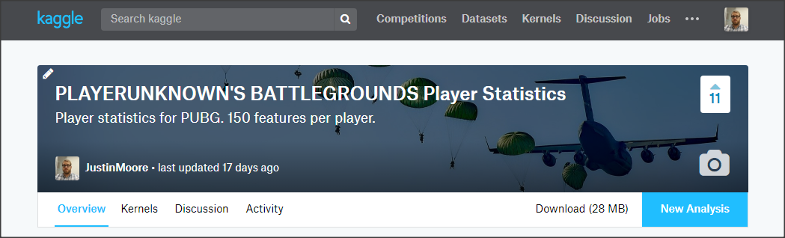
End result: Lots of new data
The final data set (after cleaning) resulted in 87,898 rows (1-per-player), and 150 numerical features related to gameplay and rank
I also made this new data set available for the data science community: https://www.kaggle.com/lazyjustin/pubgplayerstats

Slide 9
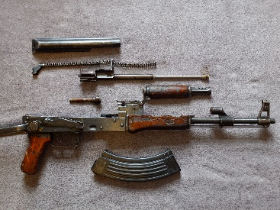

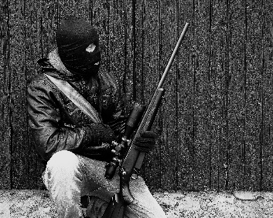
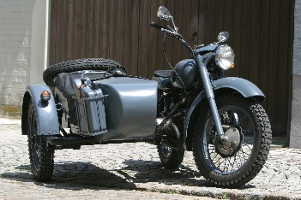
Analysis and visualization
Basic analysis and visualization
Text Analysis of player names and profanity
Longshot Analysis
Vehicle Usage and Strategy (Unsupervised Machine Learning)

Slide 10
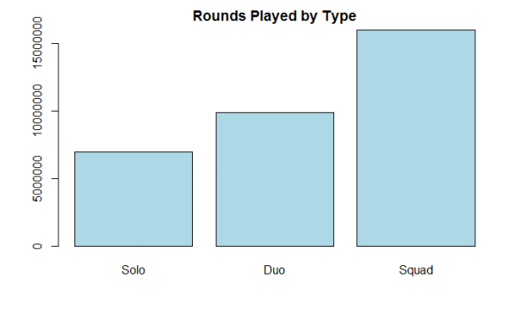
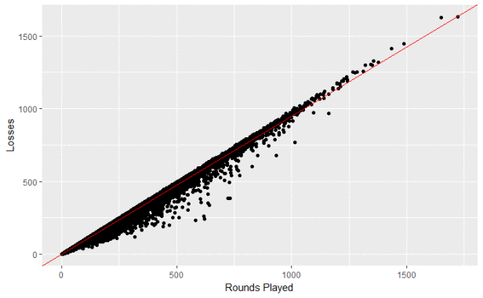
Some interesting finds…
Squad game mode dominates…
Losses are very easy to predict

Slide 11
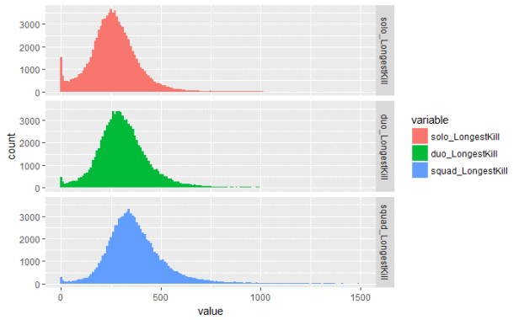
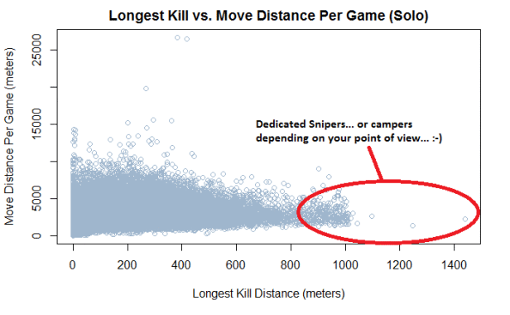
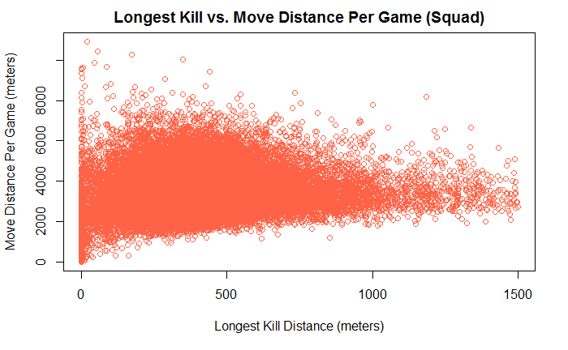
Snipers and longshots
Basic Summary
Squad modes have longer kills (on average)
The longest kills come from players that move the least (overall)
Some in-game kills are much longer than I expected…

Slide 12
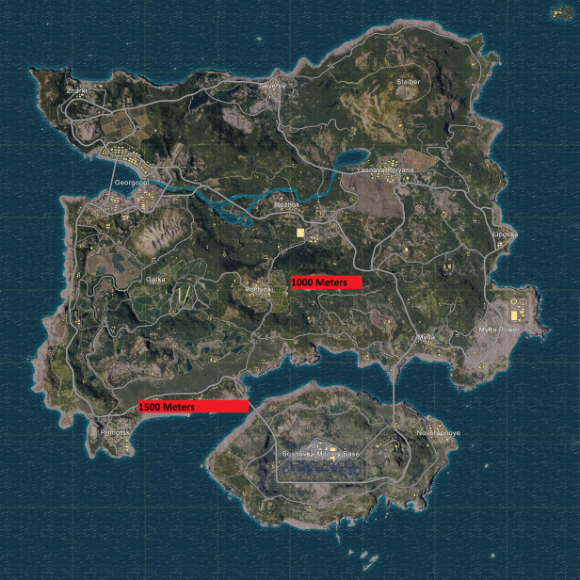
Longshots visualized with map overlays

Slide 13
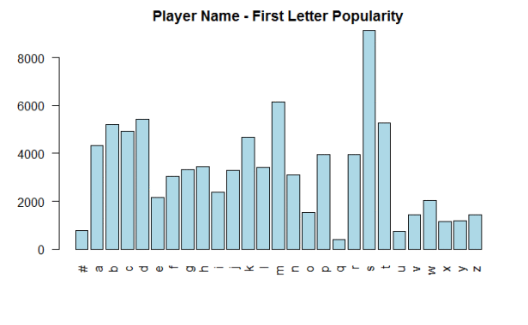
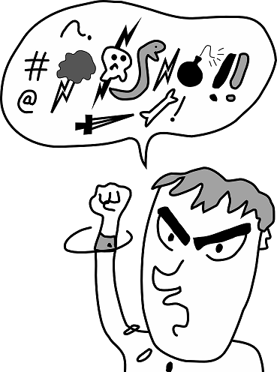
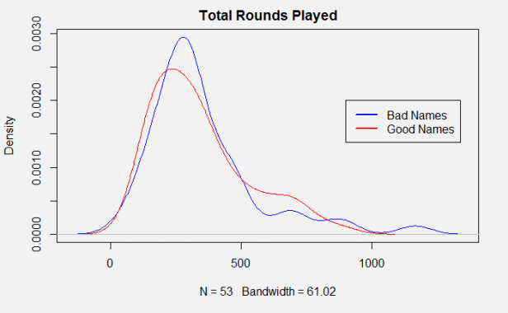
Player screen names and profanity
The letter “S” dominates for player-name first letter … ?
Players with profanity in their screen names are not being banned (even though this is a violation of the terms of service), in fact they play more rounds overall (on average)

Slide 14
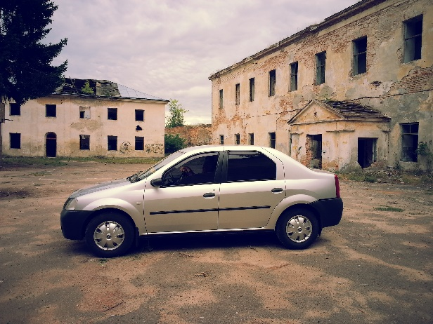
Settling the car debate…with data
There are a wide variety of vehicles in the game. Vehicles provide better protection from the enemy and better movement speed. However, vehicles are also loud and generally give away your position to the enemy.
Objective: cluster players by movement type (those that prefer vehicles over those that prefer to walk/run. Determine if the two strategies are different enough to make a difference.

Slide 15
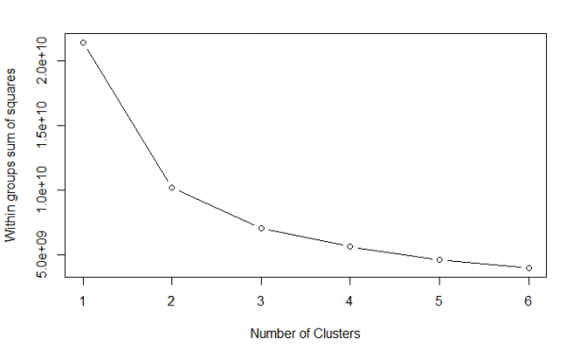
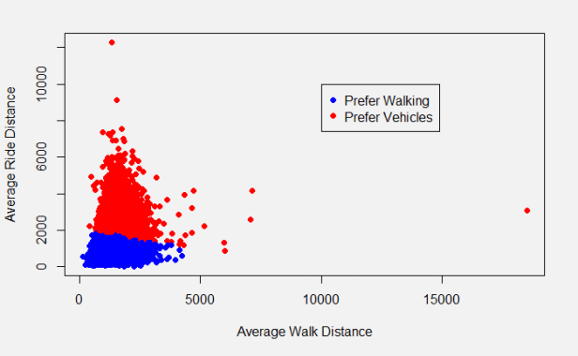
Grouping players with kmeans

Slide 16
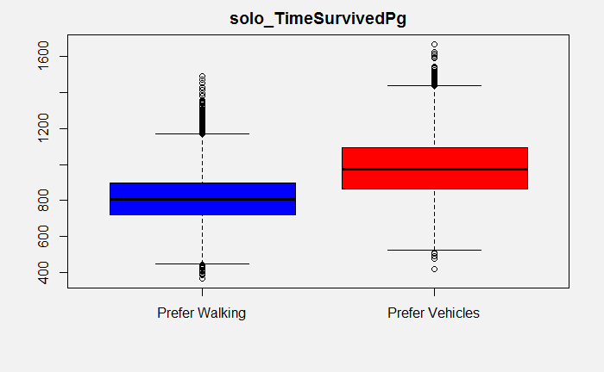
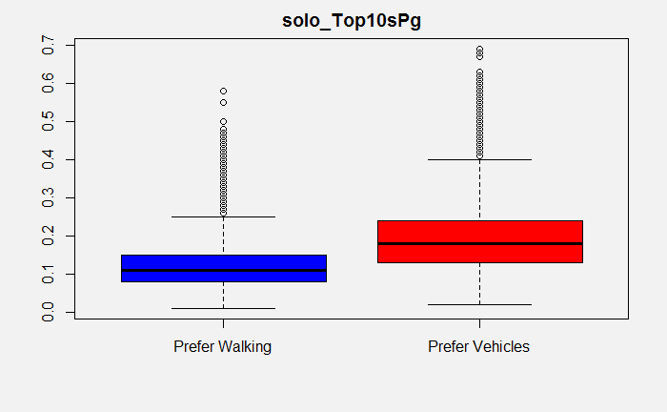
Vehicles are better… overall

Slide 17
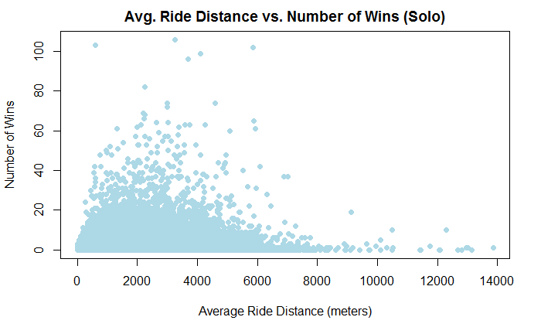
It is possible to overuse vehicles
Players that win the most tend to average around 2 – 4 km of ride distance

Slide 18
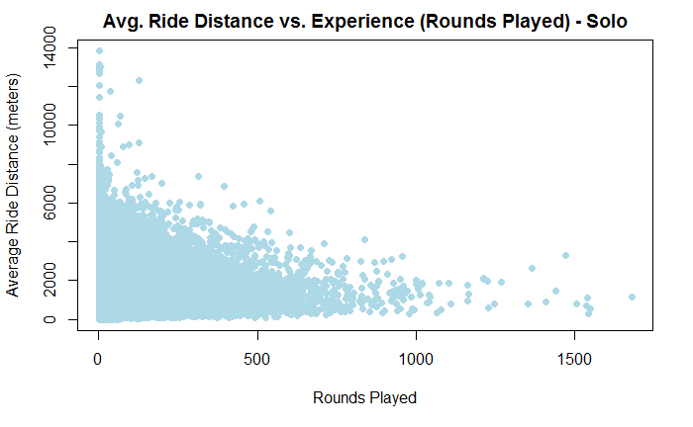
It is possible to overuse vehicles
Experienced players have a much lower average ride distance (it tapers off as players accrue more play time)

Slide 19
Next steps
Use more clustering algorithms to group like-minded players. This can be used for clan-recruiting and matchmaking suggestions
Alexa Skill for locating vehicles in-game and fetching player statistics (out for Certification)
More contributions to the Kaggle data set (as new metrics become available)
Keep updating the blog (https://pubganalysis.wordpress.com/)

Slide 20
Q and a
Questions

